Slide 1
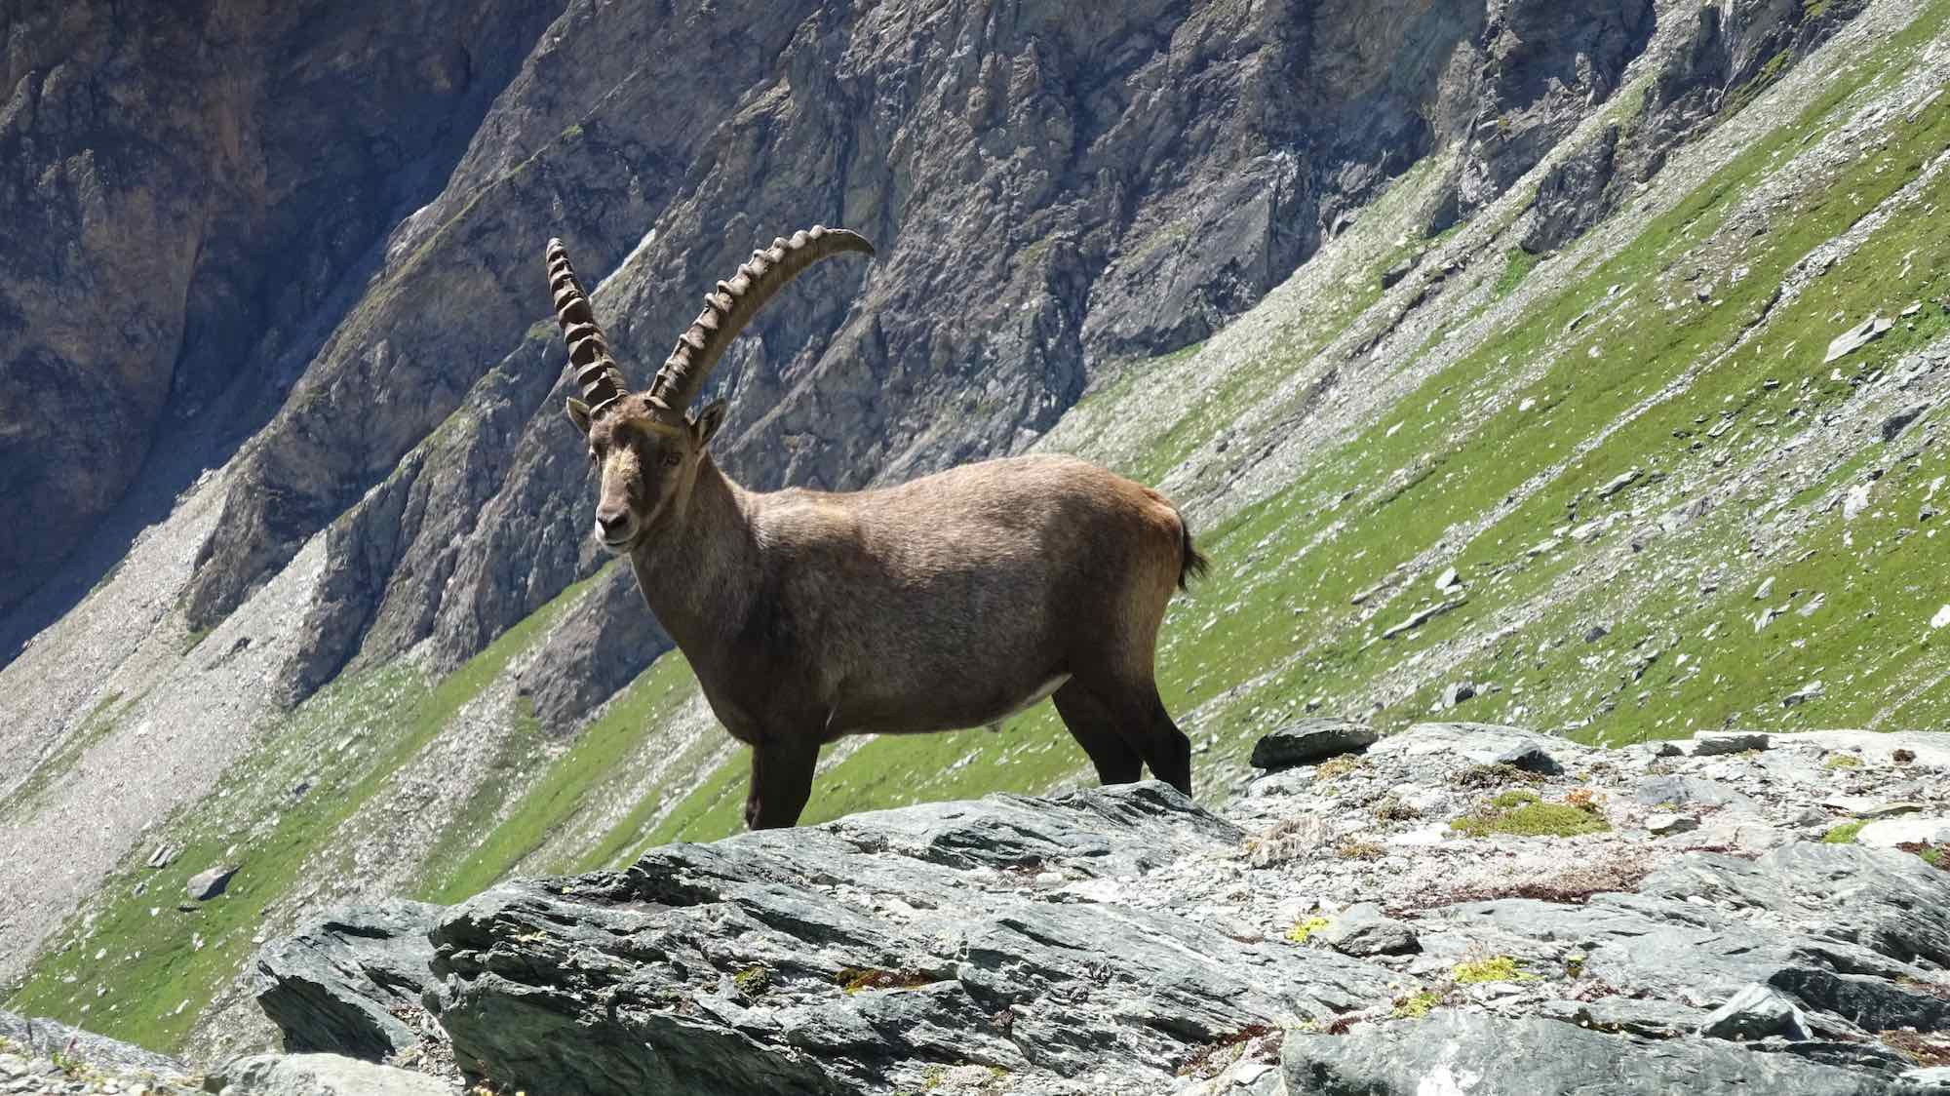
Ibex
Hunted to almost extinction

Slide 2
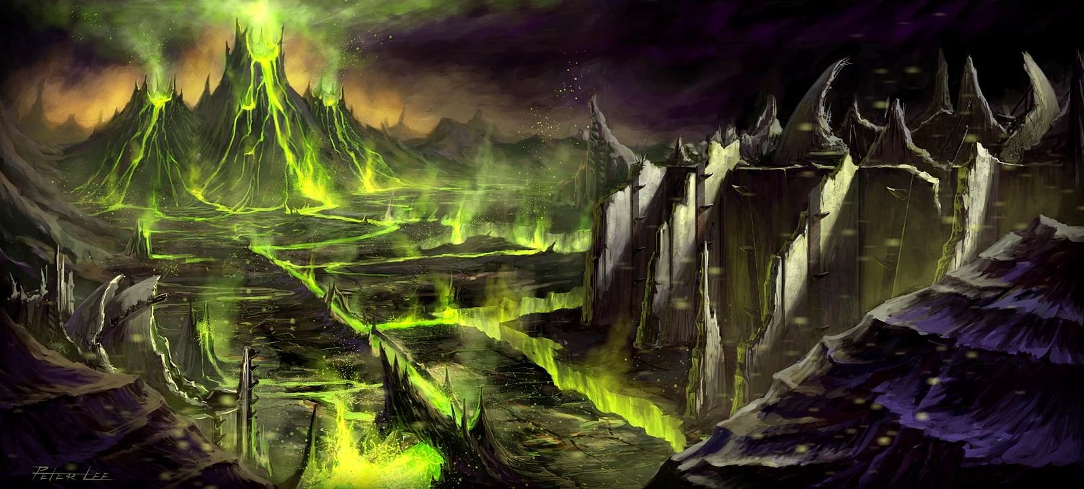
But there is a small population left in the…
Shadow valley

Slide 3
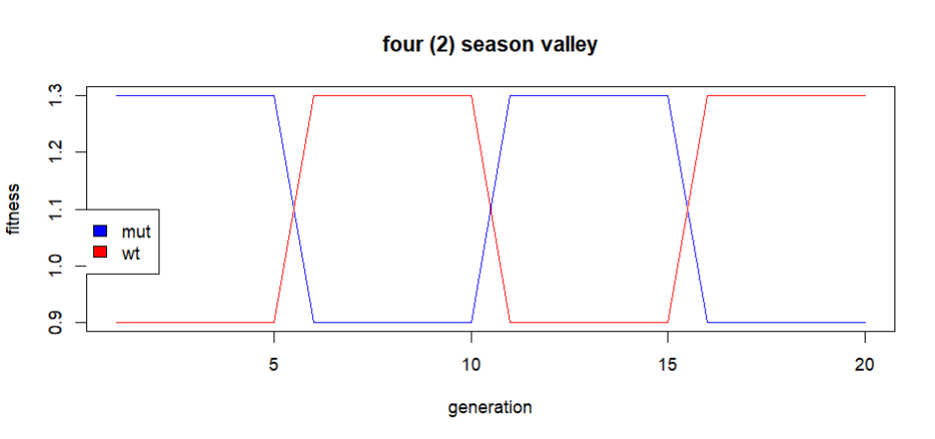
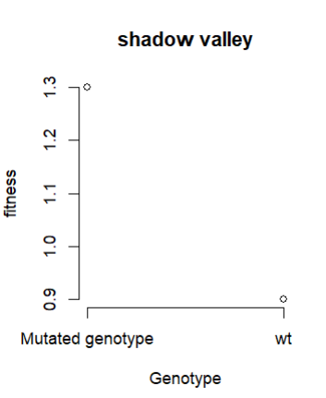
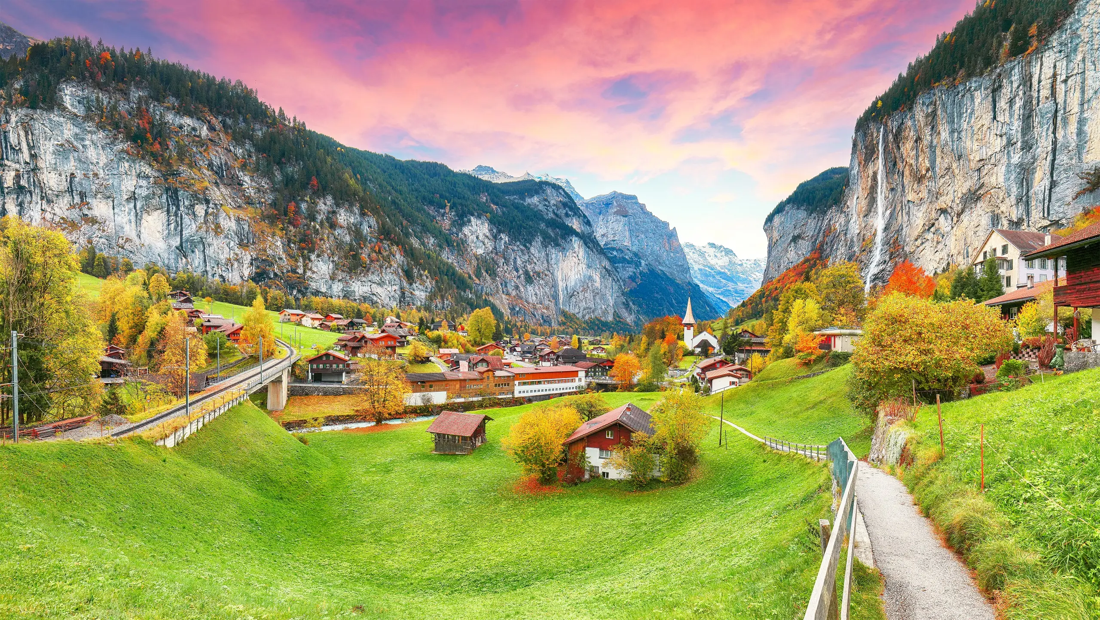

Slide 4
How does Season time affect rescue probability on different migration rates?
Evolutionary rescue model, with back mutation rate
Evolutionary rescue model, with changing fitness & back mutation rate

